Slide 1

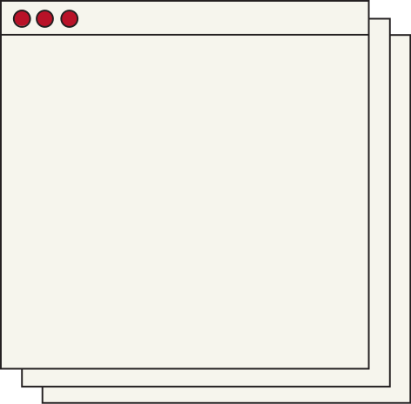


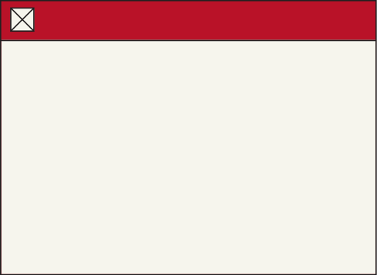



HTML
CSS
OR VIII ASISTEN LDKOM

Slide 2
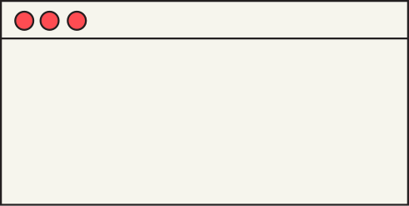
HTML

Slide 3



HTML?
<!DOCTYPE html>
<html>
<head>
<title>Page Title</title>
</head>
<body>
<h1>My First Heading</h1>
<p>My first paragraph.</p>
</body>
</html>
Hyper Text Markup Language
start with a document type declaration: <!DOCTYPE html>
begins with <html> and ends with </html>
visible part of the HTML document is between <body> and </body>

Slide 4
Tags
<!DOCTYPE>
<title></title>
represents the document type
title for the HTML page
<html></html>
<body></body>
root element of an HTML page
the document's body
<head></head>
<h1>
contains meta information about the HTML page
large heading
<p>
paragraph

Slide 5
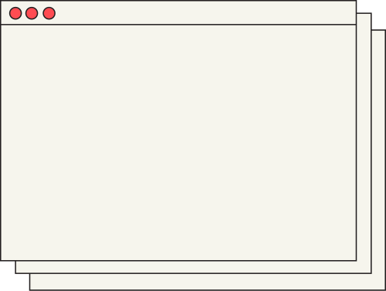
everything
from the start tag
to the end tag
HTML Elements
<tagname>
isi elemen
</tagname>

Slide 6

The HTML <head> Element
Metadata typically define the document title, character set, styles, scripts, and other meta information.
<title></title>
defines the title of the document
<style></style>
define style information for a single HTML page
<link> </link>
defines the relationship between the current document and an
external resource.
<meta></meta>
specify the character set, page description, keywords,
author of the document, and viewport settings.

Slide 7
The HTML <body> Element
containing visible contents
<h1> to <h6>
Defines HTML headings
<br>
Inserts a single line break
<hr>
Defines a thematic change in the content
<!--...-->
Defines a comment
<div>
Defines a section
<form>
Defines a form

Slide 8
CSS

Slide 9
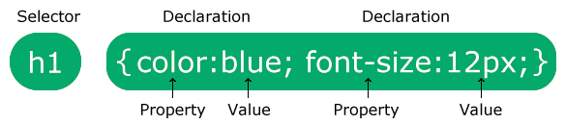
Cascading Style Sheets.
how HTML elements are to be displayed
CSS?
Ways to add CSS :
Inline - by using the style attribute inside HTML elements
Internal - by using a <style> element in the <head> section
External - by using a <link> element to link to an external CSS file

Slide 10

Examples (1/2)
In Line
Internal
<h1
style="color:blue;">
A Blue Heading
</h1>
<!DOCTYPE html>
<html>
<head>
<style>
body {background-color: powderblue;}
h1 {color: blue;}
</style>
</head>
<body> <h1>This is a heading</h1> </body>
</html>

Slide 11
Examples (1/2)
External
contoh.html
styles.css
<!DOCTYPE html>
<html>
<head>
<link rel="stylesheet"
href="styles.css">
</head>
<body>
<h1>This is a heading</h1>
<p>This is a paragraph.</p>
</body>
</html>
body {
background-color: powderblue;
}
h1 {
color: blue;
}
p {
color: red;
}

Slide 12
Attributes
color
border
text colors
borders
font-family
padding
text fonts
space inside the border
font-size
margin
text sizes
space outside the border

Slide 13
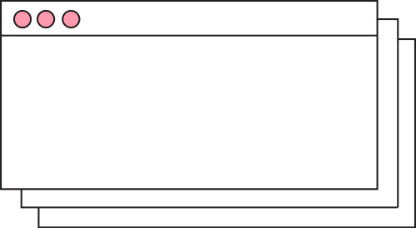
Practice makes perfect . . .
Bikin web tentang dirimu
Minimal 2 halaman
Maksimal tidak ada batasan

Slide 14
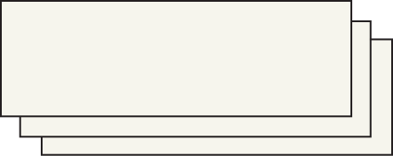
Terima Kasih
dan semangat nugas

